Slide 1


State of the Industry
Equipment trends and usage in Wisconsin’s
custom manure application industry
Kevin Erb
Jerry Clark
Richard Halopka
University of Wisconsin, Madison, Division of Extension

Slide 2

Significant changes in 2022
Several larger firms downsized or left the industry
21 firms left the industry
  17 closures, 1 family transition and 3 changed owners
13 additional brand new firms
  Many are smaller, semi owner/operators
  5 new ones in 2023 (as of 3/1), most smaller

Slide 3
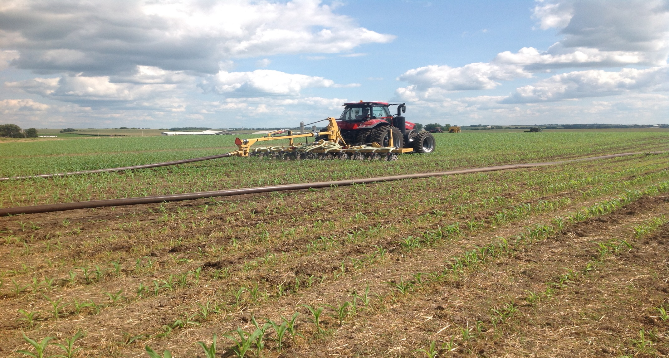
Entry/Exit Trends
Year | New Firms | Exit
2016 | 8 | 8
2017 | 17 | 9
2018 | 12 | 8
2019 | 14 | 8
2020 | 9 | 14
2021 | 21 | 5
2022 | 13 | 21
Photo: Cheryl Skjolaas

Slide 4
Significant changes in 2022
Move from firms owning semis/tankers to partnering with owner/operators (o/o) due to shortage of qualified CDL drivers for seasonal ag operations
  Larger firms maintain lists of 10-40 o/o
  Farms owning tankers, partnering with o/o
  Change evident in semi trends

Slide 5
Semis, trucks, tractor tankers and semi tankers

Slide 6
Equipment Trends – Dragline hose size (miles)

Slide 7
Equipment Trends – Dragline hose (total miles)

Slide 8
Technology: GPS as-applied mapping usage

Slide 9
Long distance transfer: switching from frac tanks to dumpsters

Slide 10
Solid Spreaders – tractor and truck mounted

Slide 11
Solid Spreaders – tractor and truck mounted

Slide 12
Overall trends
The industry is adjusting to the labor challenge in agriculture
  More owner/operators with semis
  Larger diameter hoses

Slide 13
Technology adoption
Those that save costs (fuel) or labor are more rapidly adopted than those that improve nutrient management implementation
  Adoption of boats, change in hose size, semis for manure transport vs. low disturbance injectors and nutrient sensors

Slide 14
Technology adoption
  Technology that benefits both trends midway between (GPS as applied mapping)

Slide 15
Acknowledgements
Extension Team Members
Jerry Clark
Kevin Erb
Richard Halopka
More than 200 manure applicators in Wisconsin that shared their information

